Slide 1
Android Wear
Tony Constantinides, Senior Manager
Ed Murphy, Senior Software Engineer
Capital One 360 Café | January 21 2015

Slide 2
Wear : Introduction
Welcome to Wear!
We cover Android Wear developer topics to get you up and rolling with Android Wear
We have several demos to keep you awake and interested.
The topics are back up by the online documentation with tips and trips added base on practical hands on experience

Slide 3
Wear : Introduction
What Are Android Wear Devices
Most Use a Qualcomm SnapDragon 400 1.2 processor expect Mote 360
All Support Bluetooth 4.0 and some 4.1
Some are Dust and water resistant
Battery of 410 mAh or smaller
1.3 inch screen of 320 by 320 is typical

Slide 4
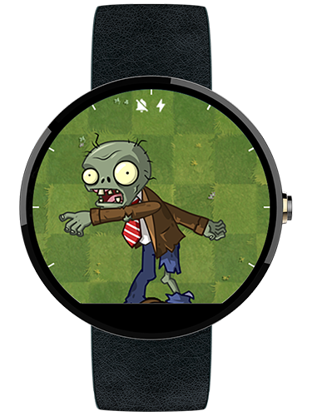
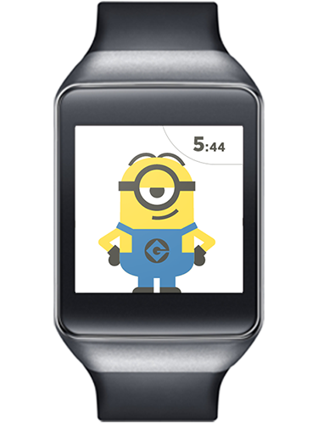
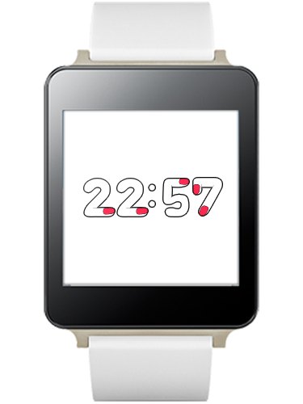
Meet the devices- first wave
Wear : Introduction
All released in 4.4W KitKat (left to right)
Moto 360, (Bluetooth only, slowest processor, sexy)
Samsung Gear Live (unattractive)
LG G Watch (USB, Bluetooth)

Slide 5
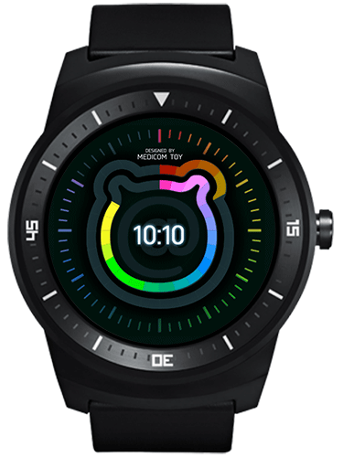
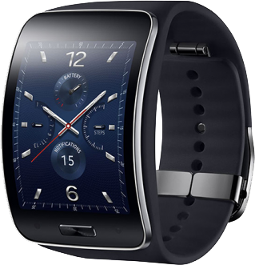
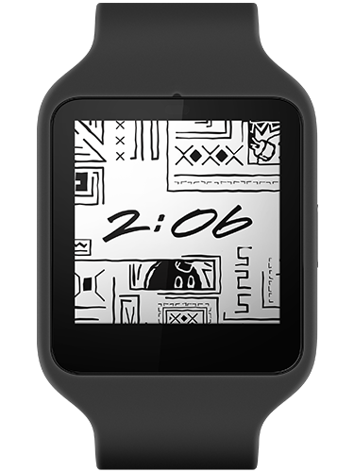
Wear : Introduction
Meet the devices - second wave (all support wear 5.0.1)
All with heart rate monitors, GYRO & Accelerometer (left to right)
LG R Watch (Barometer, rugged style)
Samsung Gear S Watch (3G – phone calls)
Sony SmartWatch 3 (GPS)

Slide 6
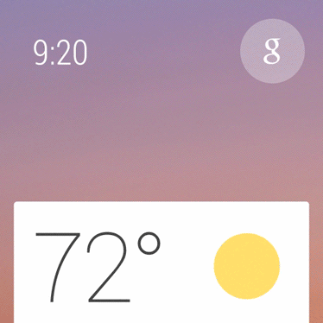
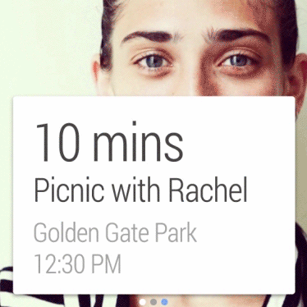
Wear : Introduction
The Wear Experience – Material Design
Notes:
Android wear was a pioneer of Material Design:
Material design “officially” released with API 21 (Lollipop) last November but the original Wear SDK 4.4W released in April had already begun implementing some of it’s greatest features, such as:
enhanced animation and flow, utilizing animation effects such as ripple
interactive UX elements – giving the user a sense of complete control while managing their content
quicker content delivery – the navigation feels predictive with a “right when you need it” sensibility
As you’ll see later when we cover UX best practices, Google suggests you
Develop your wear applications in a contextual way. Meaning the user does not launch apps per sey, but suggested apps are made available based on current user behavior.
developers are also strongly encouraged to supply users with a priority first option, while selectable lower priority options are secondary

Slide 7
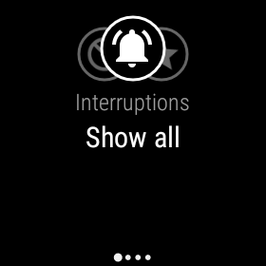
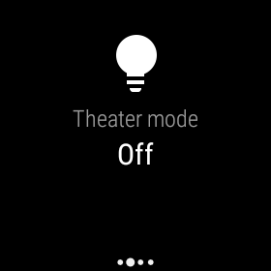
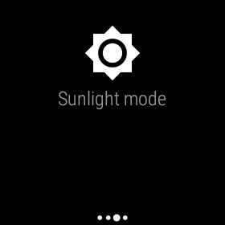
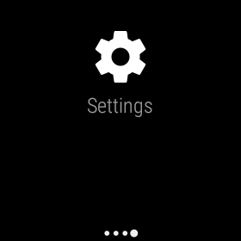
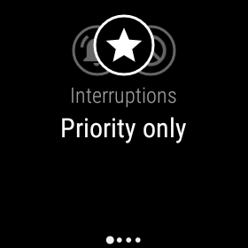
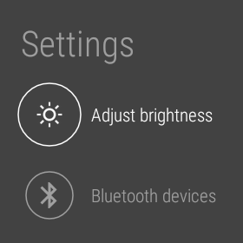
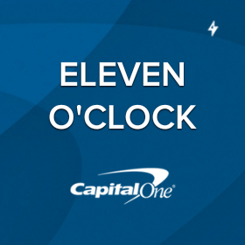
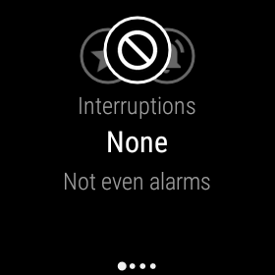
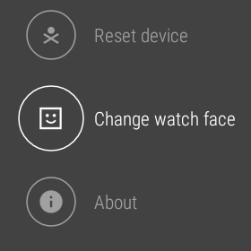
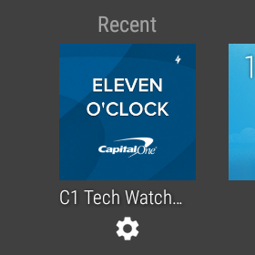
Wear : Introduction
The Wear Experience – Quick Settings
Notes:
A good use of this Material concept can be found in the Quick Settings panel.
It’s found by swiping from the top edge down while on the home screen, much like the quick settings found in the notifications panel on your device.
It allows you to set how your wear handles interruptions
show all
priority only (set via the application settings)
none
Set it to theater mode, muting the wear and its screen. Double tap takes you out.
Sunlight mode for increasing the backlight when you need it
And the full settings panel for adjusting all kinds of features including
- about device info
- setting your watch face

Slide 8
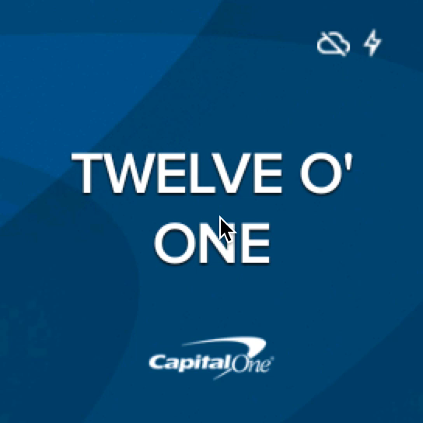
Wear : Introduction
The Wear Experience – Quick Settings
Notes:
A good use of this Material concept can be found in the Quick Settings panel.
It’s found by swiping from the top edge down while on the home screen, much like the quick settings found in the notifications panel on your device.
It allows you to set how your wear handles interruptions
show all
priority only (set via the application settings)
none
Set it to theater mode, muting the wear and its screen. Double tap takes you out.
Sunlight mode for increasing the backlight when you need it
And the full settings panel for adjusting all kinds of features including
- about device info
- setting your watch face

Slide 9
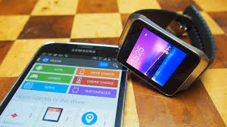
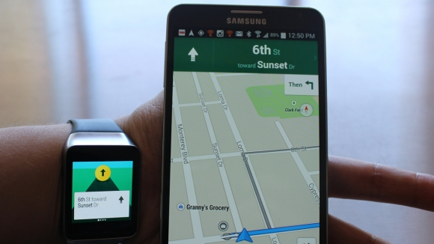
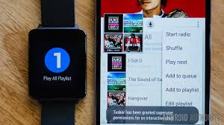
The Wear Experience – Wear Apps
Wear : Introduction
Android Wear apps work as a second screen to your mobile app. There are a mobile extension and not a really small smartphone.

Slide 10
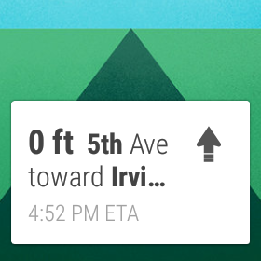
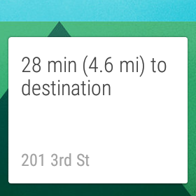
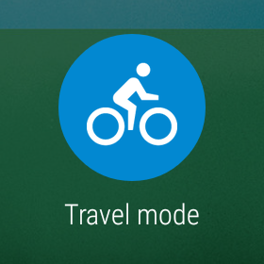
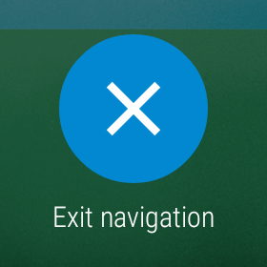
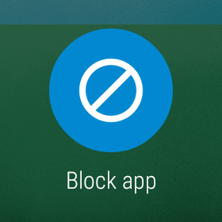
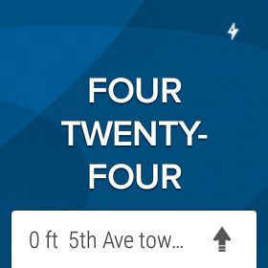
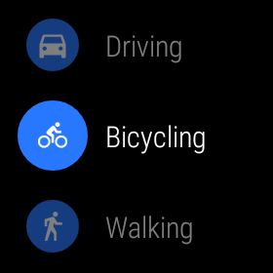
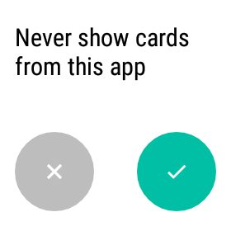
Wear : Introduction
The Wear Experience – Navigation
Notes:
Google navigation is obviously great, we’ve all used it, but when paired to a wearable, your navigation gets much more convenient.
Contextual card in the stream : you’re presented with turn by turn notifications while navigation is currently running on your device.
Prompting you at each up coming turn, as the app inserts notifications
You also have the ability to dig deeper and
see the full destination information
change the travel mode
and exit the navigation
All Wear applications that implement “Pages” get this default Block app page. Developers do not create nor edit this default page.
If selected, you have to launch the Android Wear companion settings application to begin receiving notifications again.

Slide 11
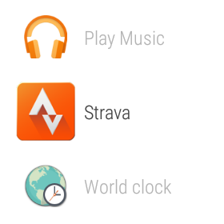

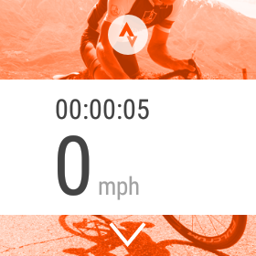
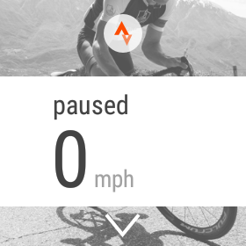
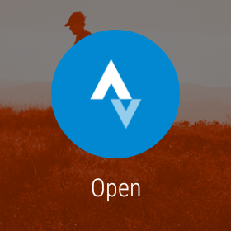
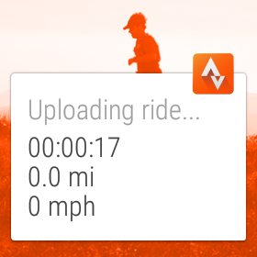
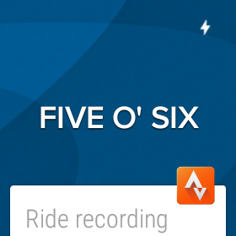
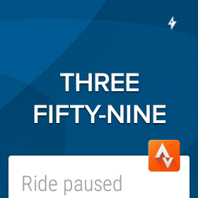
Wear : Introduction
The Wear Experience – Strava
Notes:
Strava : Custom Application
Strava uses your device gps to calculate your bike or run. In this case we started a bike ride.
You have the option to pause, start, open the ride on the device and complete/sync a ride.
If you are in an area where your device is not connected, it will wait to sync your ride until it has.

Slide 12
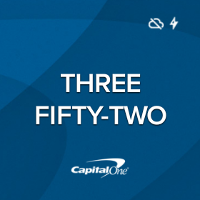
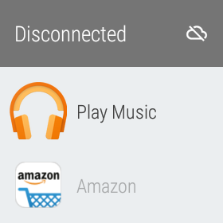
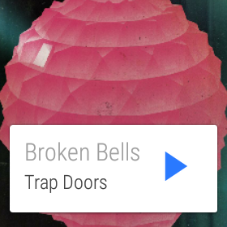
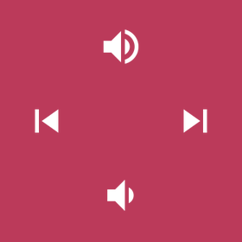
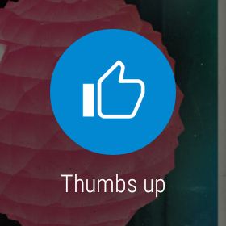
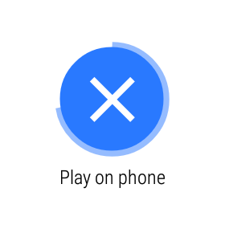
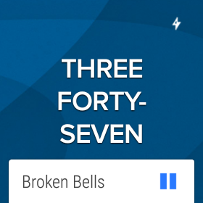
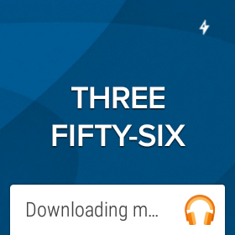
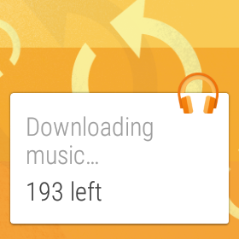
Wear : Introduction
The Wear Experience – Play Music : Offline Mode
Offline Support
Notes:
Play Music : Offline use
Your wear can still function while not connected to the host device. Some apps even let you sync data to the internal storage to keep the application available.
For instance Play Music allows you to store music data to the wearable and play music offline.
Enable “Download to Android Wear” from the Play Music phone application settings.
While the device is connected to your wear, it will download any music you downloaded to the phone for offline use.

Slide 13

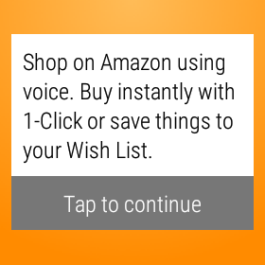
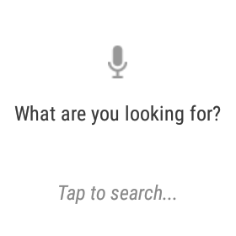
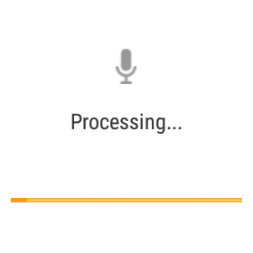
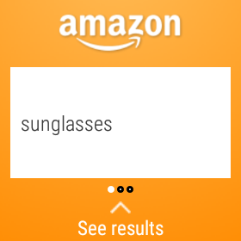






Wear : Introduction
The Wear Experience – Amazon
Notes:
Amazon : Speak Recognition
What are you looking for feature is voice recognition searching, in this case I searched sunglasses.
It processed my search and returned a list of sunglasses, which I can view on my phone if

Slide 14







Wear : Introduction
The Wear Experience – Notes : Voice Commands
Notes:
Notes : Voice Commands : Cue Cards
The Notes application that bundles with the SDK includes voice recognition for saving and syncing notes to Android Keep.
After speaking now “do the dishes”, you’re presented with a timed cancel button
Once saved, you can open the note in either Google Keep on the phone or the Watch
You can even Archive your notes directly from wear

Slide 15



Android Wear on Google Play look
Wear : Introduction
You must install Android Wear app from Google Play Store

Slide 16
What Can Android Wear Apps Do
Wear : Introduction
You can write sophisticated phone management software
You can write data organization software
You can write Games!
You can develop custom Watch faces!
And much much more only limited by your imaginations

Slide 17
What about gaming applications? Can games be ported to Wear?
Wear : Introduction
Sure its an Qualcomm Adreno 305 GPU.
I use Game Engine libGDX sample code to port an Android game (Space Invaders) to Android Wear
Apart from build file changes I had to change 0 lines of code to port the game from Android to Android Wear.
https://github.com/libgdx/libgdx

Slide 18


Space Invaders on Wear!
Wear : Game Demo

Slide 19
Android Wear Gradle tips
Wear : Gradle
Use the same package name and application Id for both the Mobile and Wear mobiles otherwise no auto install
Use the same permission between the mobile and wear app (exactly), otherwise auto install will not work
If using “product flavors” set “publishNonDefault true” under “android’ section in your wear app build.gradle
Auto embedding the wear app by adding “wearApp project(':wear')” to your mobile dependencies in build.gradle

Slide 20
Developer setup tips
Wear : Setup
You can debug over Bluetooth but USB is much faster
Buy a cheap Android Wear watch (LG G) for development rather than the emulator
If you are sync with the watch over Bluetooth for not the first time, “reset the device” on the wearable and uninstall Android Wear app from your mobile. The wear app will reinstall and ask you to download android wear for your handheld and once done with connect over Bluetooth. This is the only clean way to connect.

Slide 21

Android Studio : Project Creation
Notes:
Welcome to Android Studio
You are presented this screen at startup if a project was not previously open when you closed it.
Any recently created projects will be in the recent projects panel.

Slide 22

Android Studio : Project Creation
Notes:
Application Name –
+
Company Domain –
Combines to form the unique Package Name of your application

Slide 23

Android Studio : Project Creation
Notes:
Phone Tablet SDK
Wear works with devices running API 4.3 or higher
Wear has been available since API 20 (KitKat Wear) version 4.4W
It is now up to API 21 version 5.0

Slide 24

Android Studio : Project Creation
Notes:
Add a Main Launcher Activity to your mobile module
Can contain a fragment or be one of these other template activities we never use.

Slide 25

Android Studio : Project Creation
Notes:
We give it name and associate it with a Layout

Slide 26

Android Studio : Project Creation
Notes:
Here we add an Activity for the Wear module.
Would be nice if they offered a few templates…

Slide 27

Android Studio : Project Creation
Notes:
Here we name our activities.
Studio by default injects the Multi Layout solution for square versus round faces, meaning you have three base activities in your wear module.
We’ll cover this layout paradigm shortly a few slides later.

Slide 28

Android Studio : Project Creation
Notes:
For all the Studio users this should look very familiar. The project structure is broken into two modules, Mobile versus Wear.
This project can compile two separate apks, one for Mobile and one for Wear.
However, the Mobile apk will include the Wear apk and automatically install the wear apk to a paired wear device.

Slide 29




Android Studio : Project Creation
Notes:
Emulator creation is handled in the AVD, or Android Virtual Device Manager.
Here I have two emulators set up, both targeting 5.0.1 devices

Slide 30
Android Studio : Project Creation
Notes:
Emulator creation is handled in the AVD, or Android Virtual Device Manager.
Resolution:
Nexus 5 - 1080 x 1920 xxhdpi
Round – 320 x 320 hdpi
Square – 280 x 280 hdpi

Slide 31



Android Studio : Project Creation
Notes:
Quick note on importing Sample Projects. Studio supports it and includes a handy “Import an Android code sample”.
This will make a copy of the sample code so you can’t overwrite original files.
Lots of wear samples, so be sure to download the latest Wear Sample Code found in the SDK Manager.

Slide 32
To use Notifications use the Android support library
Wear : Notifications
You do not have to use this on mobile unless you want a summary notification that shows on the handheld as well as the wearable
See http://developer.android.com/training/wearables/notifications/creating.html
Add this entry to your mobile build file: “compile com.android.support:support-v4:21.0.3” not the one Google states

Slide 33



Android Wear Notifications types
Wear : Notifications
Clockwise,
Summary notifications
Stacked notifications
Page notifications

Slide 34
Wear : Notifications
android.support.v4.app.NotificationCompat.Builder
Use NotificationCompat.Builder class to specify that contents of the notification(Icons, text, what activity to launch to view it)
Use the set methods to specify what you want in the notification
To Specify a response to the notification add an Action Button by using the “addAction(..)” in the builder class.

Slide 35
How to specify what code to run when the user select an action
Wear : Notifications
Using A Pending Activity to display the activity to be launched when the Action button is touched
Specify another pending delete activity when the user dismiss the current notification
// Build intent for notification content
Intent viewIntent = new Intent(this, ViewEventActivity.class);
viewIntent.putExtra(EXTRA_EVENT_ID, eventId);
PendingIntent viewPendingIntent =
PendingIntent.getActivity(this, 0, viewIntent, 0)

Slide 36





android.support.app.NotificationCompat.Action
Wear : Notifications
Built in and custom Action Buttons can be specified

Slide 37
Adding Big text to notifications
Wear : Notifications
BigTextStyle tightTurnPageStyle = new NotificationCompat.BigTextStyle();
tightTurnPageStyle.setBigContentTitle("Navigate")
.bigText("Tight turn right in 3 minutes");
// Create second page notification
Notification tightTurnPageNotification =
new NotificationCompat.Builder(this)
.setStyle( tightTurnPageStyle )
.build();

Slide 38

Big Style Notifications
Wear : Notifications

Slide 39
Builder In Total
Wear : Notifications
NotificationCompat myBuilder= new NotificationCompat.Builder(this)
.setLargeIcon(mBackgroundImageBitmap)
.setSmallIcon(R.drawable.wearable_icon_30x30)
.setAutoCancel(true)
.setStyle(firstPageStyle)
.setPriority(Notification.PRIORITY_HIGH)
.setVibrate(new long[]{1000, 1000, 1000, 1000, 1000, 1000})
.setDeleteIntent(pendingDeleteIntent)
.setContentIntent(pendingDisplayIntent);

Slide 40
NotificationCompat.WearableExtender
Wear : Notifications
Add Actions, and notifications as pages to the extender.
Add screen timeout periods, set Display Intents, set Content when watch is offline with its handheld, set content height, set hints, set hint icons, show only the background of hints, set the bottom to scroll, etc

Slide 41



Google Maps Navigations
Wear : Notifications
Multiple Page notifications example

Slide 42
Use the extender for multi page
Wear : Notifications
NotificationCompat.WearableExtender extender
= new NotificationCompat.WearableExtender()
.addPage(secondPageNotification)
.addPage(googleMapsPageNotification)
.addPage(leftTurnPageNotification)
.addPage(tightTurnPageNotification)
.addAction(action);

Slide 43
Add the extender and send the notification
Wear : Notifications
Notification notification = builder
.extend( extender )
.build();
NotificationManagerCompat notificationManagerCompat
= NotificationManagerCompat.from(this);
notificationManagerCompat.notify(notificationId++, notification);

Slide 44
Data Layer communications
Wear : Notifications
Three Interfaces using Google Play Services
com.google.android.gms.wearable.DataApi.DataListener
com.google.android.gms.wearable.MessageApi.MessageListener
com.google.android.gms.wearable.NodeApi.NodeListener

Slide 45

The Android Wear software Architecture
Wear : Notifications

Slide 46

Detail:
Wear : Notifications

Slide 47
NodeListener
Wear : Notifications
Used when the wear device is in or out of touch with the handheld over Bluetooth
Have to implement 2 methods
onPeerConnected(
com.google.android.gms.wearable.Node node
);
onPeerDisconnected(
com.google.android.gms.wearable.Node node
);

Slide 48
DataApi.DataListener
Wear : Notifications
void onDataChanged(
com.google.android.gms.wearable.DataEventBuffer dataEventBuffer);
Called when data item objects are created, changed, or deleted. An event on one side of a connection triggers this callback on both sides.

Slide 49
MessageApi.MessageListener
Wear : Notifications
onMessageReceived(com.google.android.gms.wearable.MessageEvent messageEvent);
A message sent from one side of a connection triggers this callback on the other side of the connection.
A MessageEvent is passed that contains data, which uri sent it and the source node id (handheld)

Slide 50
WearableListenerService
Wear : Notifications
Create a Service class that extends from WearableListenerService in you wearable
This service runs in the background on the wearable and responds when the handheld sends data to it via notifications or via one of its data layer interfaces (e.g. like DataApi.DataListener)
You specify in the wearble manifest the intent filter to bind the service needed

Slide 51


Wear : Layouts
UX – Layouts : Round and Square
Multi Support Layout - android.support.wearable.view.WatchViewStub
Shape Aware Layout - android.support.wearable.view.BoxInsetLayout
Design Guidelines : https://developer.android.com/design/wear/index.html
Notes:
Round versus Square Layouts
Layout creation in Android Wear is identical to that of the full Android applications. However, as a developer you have to account for the two current wearable form factors, Round & Square.
This issue you see here describes what happens by default when inflating a simple layout with text view to your custom wear activity.
Two approaches for handling this layout conundrum are…
Multi Layout
and
Shape Aware Layout
Android does a really great job of covering this topic in detail at this address.

Slide 52

Wear : Layouts
UX – Multi Layout
<!-- main_activity.xml -->
<android.support.wearable.view.WatchViewStub
xmlns:app="http://schemas.android.com/apk/res-auto"
android:layout_width="match_parent"
android:layout_height="match_parent"
android:id="@+id/stub"
app:rectLayout="@layout/rect_layout"
app:roundLayout="@layout/round_layout"/>
…
//MainActivity.java
@Override
public void onCreate(Bundle b) {
super.onCreate(b);
setContentView(R.layout.main_activity);
WatchViewStub stub = (WatchViewStub) findViewById(R.id.stub);
stub.setOnLayoutInflatedListener(new WatchViewStub.OnLayoutInflatedListener() {
@Override
public void onLayoutInflated(WatchViewStub stub) {
mRectBackground = (RelativeLayout) findViewById(R.id.rect_layout);
mRoundBackground = (RelativeLayout) findViewById(R.id.round_layout);
}
});
}
Notes:
Multi Layout : Responsive Approach
WatchViewStub
- A class that can inflate a specific layout, depending on the shape of the device's screen.
Define different layouts for both square and round devices, and let Wear decide which to show via a WatchViewStub View.
This will inflate either layout defined by rectLayout or roundLayout in the call to setContentView()
You can get a reference to either layout by listening for the onInflate method of the WatchVewStub View.

Slide 53


Wear : Layouts
UX – Shape Aware Layout
<!-- main_activity.xml -->
<android.support.wearable.view.BoxInsetLayout
xmlns:android="http://schemas.android.com/apk/res/android"
xmlns:app="http://schemas.android.com/apk/res-auto"
android:background="@drawable/robot_background"
android:layout_height="match_parent"
android:layout_width="match_parent"
android:padding="15dp">
<FrameLayout
android:layout_width="match_parent"
android:layout_height="match_parent"
android:padding="5dp"
app:layout_box=”all|top|bottom|left|right”>
Notes:
Shape Aware Layout: Responsive
BoxInsetLayout
- A FrameLayout that's aware of screen shape and can box its children in the center square of a round screen.
Extends FrameLayout
Lets you easily align views on the center or near the edges of the screen, by defining window insets.
A combination of top, bottom, left, and right. For example, "left|top" positions the child's left and top edges inside the gray square.
The all value positions all the child's content inside the gray square
In this case the 15dp padding on the BoxInsetLayout is ignored by round devices as it’s smaller than the window inset of a round device, applying it only to square devices.
This gives the round device a padding of 5dp while the square has a padding of 20dp.

Slide 54
Wear : Layouts
UX – Custom Layouts and Notifications
Custom Wear layouts and notifications ARE supported by Android. However keep these two facts in mind when considering this path:
If building a custom layout…
do not simply port functionality and the UI from a handheld app and expect a good experience
If building a custom notification…
you can issue this notification from the wearable only, it will not sync with your handheld
In either case, Google recommends you use the Wearable UI Library, which offers UI widgets that adhere to the look and functionality of Wear. This lib is automatically added as a gradle dependency when creating your project with the Android Studio wizard.
dependencies {
compile fileTree(dir: 'libs', include: ['*.jar'])
compile 'com.google.android.support:wearable:+'
compile 'com.google.android.gms:play-services-wearable:+'
}
Notes:
Custom Layouts and Notifications (to display those layouts)
When the default notification stuff won’t cut it, custom Layouts ARE supported by Android, however keep these two points in mind when doing so:
Do not simply port over functionality and UI from a handheld application and expect a good experience.
(For instance, WebViews and Menus are not supported.)
And
Any notifications issued from the wearable will NOT sync on the handheld.
Also, It’s recommended you use the Wearable UI Library widget set when designing your custom layout. This lib is automatically added as a dependency when creating your studio project with the wizard.

Slide 55


Wear : Layouts
UX – Custom Notification : Remain contextual
Google suggests you build your custom notifications with the same contextual stream construct found with default notifications. For example…
Build a notification and call setDisplayIntent() providing a PendingIntent, This pending intent is responsible for launching your custom Activity
Issue this notification by calling the notify() when needed
The system builds this notification with the standard template and “peeks” it on the wearable.
When the user swipes the notification up, it launches the Activity inflating the custom Layout.
Notes:
When building your custom notification, Google recommends that you use the same Contextual Stream Construct found with the default notifications.
Meaning it should take on the form of a “Peak” card (seen here).
Once the peak card is showing, you then launch your custom activity by swiping up on the card.
Here’s some code:

Slide 56
Wear : Layouts
UX – Custom Notification : Remain contextual
Intent intent = new Intent(this, CustomActivity.class);
PendingIntent pendingIntent = PendingIntent.getActivity(this, 0, intent,PendingIntent.FLAG_UPDATE_CURRENT);
Notification notification = new NotificationCompat.Builder(this)
.extend(new Notification.WearableExtender())
.setContentText(getString(R.string.notification_title))
.setSmallIcon(R.drawable.ic_launcher)
.setDisplayIntent(pentingIntent)
.build();
NotificationManagerCompat.from(this).notify(NOTIFICATION_ID, notification);
Notes:
Some code set up.
Create a pending intent to launch your Custom Activity
build your notification to issue the notification to the contextual stream (display the peek)
The setDisplayIntent method is the key to launching the pending intent, it’s made available thru the Notification.WearableExternder class (the highlighted content in red)

Slide 57
Wear : Widgets
UX – Widgets : Wearable UI Library
CardFrame and CardFragment
CircledImageView
ConfirmationActivity
DelayedConfirmationView
WearableListView
GridViewPager
Notes:
The Wearable UI Library provides many new Wear specific Widgets for use in your Wear Applications. These include:
CardFragment - A fragment that presents content within an expandable, vertically scrollable card.
CardFrame - Add a cardframe directly to your xml layout
CircledImageView - An image view surrounded by a circle.
ConfirmationActivity - An activity that displays confirmation animations after the user completes an action.
DelayedConfirmationView - A view that provides a circular countdown timer, typically used to automatically confirm an operation after a short delay has elapsed.
DismissOverlayView - A view for implementing long-press-to-dismiss.
WearableListView - An alternative version of ListView that is optimized for ease of use on small screen wearable devices. It displays a vertically scrollable list of items, and automatically snaps to the nearest item when the user stops scrolling.
GridViewPager - A layout manager that allows the user to both vertically and horizontally through pages of data. You supply an implementation of a GridPagerAdapter to generate the pages that the view shows.

Slide 58

Wear : Widgets
UX – Widgets : CardFragment
A fragment that presents content within an expandable, vertically scrollable card.
protected void onCreate(Bundle savedInstanceState) {
…
FragmentManager fragmentManager = getFragmentManager();
FragmentTransaction fragmentTransaction = fragmentManager.beginTransaction();
CardFragment cardFragment = CardFragment.create(
getString(“CardFragment”),
getString(“Description”),
R.drawable.icon);
fragmentTransaction.add(R.id.frame_layout, cardFragment);
fragmentTransaction.commit();
}
Notes:
The Wearable UI Library
CardFragment
A fragment that presents content within an expandable, vertically scrollable card.
Contains a title, description and icon… looks very similar to a standard card notification generated by wear
Note: Not bound to just title, description and icon, you can extend the the CardFragment class and override its onCreateContentView() method to implement your own custom layout.

Slide 59

Wear : Widgets
UX – Widgets : CardFrame
A frame that can be added directly to a resource layout.
<android.support.wearable.view.CardFrame
android:layout_height="wrap_content"
android:layout_width="fill_parent">
<LinearLayout
android:layout_height="wrap_content"
android:layout_width="match_parent"
android:orientation="vertical"
android:paddingLeft="5dp">
…
</android.support.wearable.view.CardFrame>
Notes:
CardFrame
It’s exactly like the CardFragment but can be added directly to an xml layout.
Again you can populate this CardFrame with any children you need

Slide 60



Wear : Widgets
UX – Widgets : CircledImageView
An image view surrounded by a circle.
<android.support.wearable.view.CircledImageView
app:circle_radius="30dp”
app:circle_color=“@color/blue”
app:circle_border_color=“@color/android_green”
app:circle_border_width=“4dp”
app:circle_radius_pressed="40dp”
android:layout_height="wrap_content"
android:layout_width="wrap_content"
android:src="@drawable/edit_icon"/>
Notes:
The Wearable UI Library:
CircledImageView
- An image view surrounded by a circle. Adds a circle background graphic to your image.

Slide 61

Wear : Widgets
UX – Widgets : DelayedConfirmationView
Provides a circular countdown timer, typically used to automatically confirm an operation after a short delay has elapsed.
<android.support.wearable.view.DelayedConfirmationView
android:id="@+id/delayed_confirm"
android:layout_width="40dp"
android:layout_height="40dp"
android:src="@drawable/cancel_circle"
app:circle_border_color="@color/lightblue"
app:circle_border_width="4dp"
app:circle_radius="16dp">
…
mDelayedView.setTotalTimeMs(1000); //one second
mDelayedView.start();
Notes:
The Wearable UI Library
DelayedConfirmationView
- A view that provides a circular countdown timer, typically used to automatically confirm an operation after a short delay has elapsed.
Extends the CircledImageView, which adds the image in a circler shape
The delay is intended to give the user a chance to cancel the operation by tapping the View.
Set the count down timer and
Call its start() method (of the DelayedfConfirmationView) to activate the timer
Handling callbacks is easy, just
Implement the DelayedConfirmationView.DelayedConfirmationListener in your activity and override the onTimerFinished() and onTimerSelected() method callbacks

Slide 62

Wear : Widgets
UX – Widgets : DelayedConfirmationView
Notes:
The Wearable UI Library
DelayedConfirmationView
- A view that provides a circular countdown timer, typically used to automatically confirm an operation after a short delay has elapsed.
Extends the CircledImageView, which adds the image in a circler shape
The delay is intended to give the user a chance to cancel the operation by tapping the View.
Set the count down timer and
Call its start() method (of the DelayedfConfirmationView) to activate the timer
Handling callbacks is easy, just
Implement the DelayedConfirmationView.DelayedConfirmationListener in your activity and override the onTimerFinished() and onTimerSelected() method callbacks

Slide 63


Wear : Widgets
UX – Widgets : ConfirmationActivity
An activity that displays confirmation animations after the user completes an action.
Three animation versions to choose from:
SUCCESSFUL_ANIMATION
FAILURE_ANIMATION
OPEN_ON_PHONE
Add the activity to your manifest:
<activity android:name="android.support.wearable.activity.ConfirmationActivity”/>
Set the confirmation intent and launch the activity at the appropriate time.
Intent intent = new Intent(this, ConfirmationActivity.class);
intent.putExtra(ConfirmationActivity.EXTRA_ANIMATION_TYPE,
ConfirmationActivity.SUCCESS_ANIMATION);
startActivity(intent);
Notes:
The Wearable UI Library
ConfirmationActivity - An activity that displays confirmation animations after the user completes an action.
Show Confirmation Animations
To show a confirmation animation when users complete an action in your app, create an intent that starts ConfirmationActivity from one of your activities. You can specify one of the these animations with the EXTRA_ANIMATION_TYPE intent extra:
SUCCESS_ANIMATION
FAILURE_ANIMATION
OPEN_ON_PHONE_ANIMATION
You can also add a message that appears under the confirmation icon.

Slide 64

Wear : Widgets
UX – Widgets : ConfirmationActivity
Notes:
The Wearable UI Library
ConfirmationActivity - An activity that displays confirmation animations after the user completes an action.
Show Confirmation Animations
To show a confirmation animation when users complete an action in your app, create an intent that starts ConfirmationActivity from one of your activities. You can specify one of the these animations with the EXTRA_ANIMATION_TYPE intent extra:
SUCCESS_ANIMATION
FAILURE_ANIMATION
OPEN_ON_PHONE_ANIMATION
You can also add a message that appears under the confirmation icon.

Slide 65
Wear : Widgets
UX – Widgets : WearableListView
Optimized for ease of use on small screen wearable devices. It displays a vertically scrollable list of items, and automatically snaps to the nearest item when the user stops scrolling.
Adapter/ViewHolder Pattern:
Add a WearableListView element to your activity's layout definition.
Create a custom layout implementation for your list items.
Use this implementation to create a layout definition file for your list items.
Create an adapter to populate the list.
Assign the adapter to the WearableListView element.
Notes:
The Wearable UI Library provides many new Wear specific Widgets for use in your Wear Applications. These include:
WearableListView - An alternative version of ListView that is optimized for ease of use on small screen wearable devices. It displays a vertically scrollable list of items, and automatically snaps to the nearest item when the user stops scrolling.
To create a list in your Android Wear apps:
Add a WearableListView element to your activity's layout definition.
Create a custom layout implementation for your list items.
Use this implementation to create a layout definition file for your list items.
Figure 3: A list view on Android Wear.
Create an adapter to populate the list.
Assign the adapter to the WearableListView element.

Slide 66
Wear : Widgets
UX – Widgets : WearableListView
The OnCenterProximityListener Interface for receiving callbacks when WearableListView children become or cease to be the central item.
onNonCenterPosition(boolean animate)
onCenterPosition(boolean animate)
//List Item – implements OnCenterProximityListener and overrides it’s callbacks
public class WearableListItemLayout extends LinearLayout
implements WearableListView.OnCenterProximityListener {
….
@Override
public void onCenterPosition(boolean animate) {
mName.setAlpha(1f);
}
@Override
public void onNonCenterPosition(boolean animate) {
mName.setAlpha(0.5f);
}
}
Notes:
WearableListViews extends the new support v7 RecyclerView, meaning it adheres to the same Adapter, ViewHolder pattern. With one extra goodie, the OnCenterProximityListener!
OnCenterProximityListener
Interface for receiving callbacks when WearableListView children become or cease to be the central item.
This Layout also implements the methods in the WearableListView.OnCenterProximityListener interface to fade the text in response to events from WearableListView as the user scrolls through the list.
You can also create animator objects to enlarge the icon of the center item in the list. You can use the onCenterPosition() and onNonCenterPosition() callback methods in the WearableListView.OnCenterProximityListener interface to manage your animators. Check out the ObjectAnimator class for more about obect animation

Slide 67

Wear : Widgets
UX – Widgets : WearableListView
Notes:
WearableListViews extends the new support v7 RecyclerView, meaning it adheres to the same Adapter, ViewHolder pattern. With one extra goodie, the OnCenterProximityListener!
OnCenterProximityListener
Interface for receiving callbacks when WearableListView children become or cease to be the central item.
This Layout also implements the methods in the WearableListView.OnCenterProximityListener interface to fade the text in response to events from WearableListView as the user scrolls through the list.
You can also create animator objects to enlarge the icon of the center item in the list. You can use the onCenterPosition() and onNonCenterPosition() callback methods in the WearableListView.OnCenterProximityListener interface to manage your animators. Check out the ObjectAnimator class for more about obect animation

Slide 68
Wear : Widgets
UX – Widgets : GridViewPager
Generates a 1d or 2d navigation selector based on the array
1d : array (columns)
2d : 2 dimensional array (rows and columns)
Supports Horizontal or Vertical scrolling of “pages”.
Implement a Pager Adapter to populate the GridViewPager.
A pagination indicator can be added as well.
Notes:
One caveat
When swiping up and down between rows, no matter how many cols deep you are, the pager defaults back to the first column. You can override this default by calling getCurrentColumnForRow() in the adapter and passing in the appropriate column number.

Slide 69

Wear : Widgets
UX – Widgets : GridViewPager (1d : Google Play Music)
Notes:
UX – Widgets : GridViewPager (1d : Google Play Music)
Selecting between tracks…

Slide 70

Wear : Widgets
UX – Widgets : GridViewPager (2d : Google Play Music)
Notes:
UX – Widgets : GridViewPager (2d : Google Play Music)
Selecting between albums in the first col, and then tracks…

Slide 71

Wear : Widgets
UX – Widgets : GridViewPager (2d : Google Play Music)
Notes:
UX – Widgets : GridViewPager (2d : Google Play Music)
Selecting between albums in the first col, and then tracks…

Slide 72


Wear : Watch Face
Custom Watch Face : Capital One Text Clock
Developing a custom watch face is now possible with Android Wear 5.0.1 API
Notes:
Custom Watch Faces are now available with the latest 5.0.1 API release
Prior to 5.0.1 developers where tapping in the Live Wall Paper Engine Service to create custom faces
As you’ll see, Google also took this route of extending the Live Wall Paper Service Engine
The example you see here is of a text clock.
I originally wrote a text clock as a live wall paper for DroidX device a few years ago.
When I began pouring over the android watch face docs I started to see the similarities in the approach and decided to model my watch face after my original live wall paper.

Slide 73

Wear : Watch Face
Custom Watch Face : Visual Parts
System Indicators
Hotword
Clock Data
Background
Notes:
Custom Watch Face Demo
Hotword – the “Ok Google” call out. There to remind users they request a cue card at anytime
System Indicators – If the device is charging, paired to a handle held and batter low
Clock data – is the clock information drawn to the CanvasWatchFaceService
Note:
Any other data can be shown on a clock face not just current time. Gathering that data required connection to the pair device and using the Wearable Data Layer API for sending and receiving data.

Slide 74
Wear : Watch Face
Custom Watch Face : Clock Data
The current time is retrieved by the system clock
/* set current time */
private void setTimeNow() {
currentTime = Calendar.getInstance();
hour = convertTo12Hour(currentTime.get(Calendar.HOUR));
minute = currentTime.get(Calendar.MINUTE);
}
onTimeTick() – fires every minute to refresh the time
invalidate() – to redraw the face
Notes:
Custom Watch Face Demo
You retrieve the current clock time by the system clock on startup. You refresh this current time every time the onTimeTick() method of the CanvasWatchFaceService.Engine fires.
Note:
Custom timers are needed for any animations that need to fire more often than once a minute. The seconds hand on a traditional clock face is a good example of this.
Just want to be sure the custom timer is turned off when in ambient mode to conserve power.

Slide 75

Wear : Watch Face
Custom Watch Face : Modes
Interactive
Ambient
Conserving power is key when developing watch faces!
Notes:
Custom Watch Face Demo
Watch faces support two modes, Interactive and Ambient
Interactive mode is when the watch face is awake and displaying active contextual cards in the stream
Designated for:
custom animations and graphics to be displayed
Ambient mode is when the watch face is sleeping and displaying on the the most recent contextual card in the stream
Designated for:
conserving battery with no custom animations or graphics
Note:
Some devices support low bit mode and burn in protection while in ambient mode. You’ll need to detect for these properties and change the watch face accordingly.
For instance, if the device supports
Low bit property : revert any anti alias fonts as the device will not show a smooth font anyway whilst in ambient mode
Burn In : keep content from the edges of the screen as the device will shift this content around to avoid burn in
Can check for both use cases in the onPropertiesChanged(Bundle properties) of the CanvasWatchFaceService.Engine class

Slide 76
Wear : Watch Face
Custom Watch Face : Behind the scenes
CanvasWatchFaceService
onCreate() – Instantiate the .Engine Builder
CanvasWatchFaceService.Engine
onCreate()
onDraw()
onAmbientModeChanged()
onVisibilityChanged()
onTimeTick()*
Notes:
Custom Watch Face Demo
A watch face is a Service, the CanvasWatchFaceService to be exact
Your watch face service extends the CanvasWatchFaceService and instantiates the CanvasWatchFace Builder Engine when it’s first created
This Engine class gives you all the necessary callbacks needed to compile a face, including
onCreate() – define your reusable fields and get the current time
onDraw() – draw the parts that make up the clock face
onAmbientModeChanged() – change the face based on interactive/ambient
onVisibilityChanged() – stop a custom timer if running
onTimeTick() – fires once a minute in ambient mode*
*Interactive mode, use either the customer timer or a broadcast receiver ACTION_TIME_TICK (which also fires once a minute)
Register this service:
You register this Service in your mainifest like any other, setting the,
Intent-Filter Action = android.service.wallpaper.WallPaperService
Intent-Filter Category = com.google.android.wearable.watchface.category.WATCH_FACE
This registered service is also where you define the meta-data for the Preview images when selecting your watch face and the Configuration activities for customizing your Watch Face
…to name a few

Slide 77



Wear : Watch Face
Custom Watch Face : Configuration and previews
Configuration Activity
Selection
Previews
Notes:
Custom Watch Face Demo
Configuration:
Watch Faces support configuration, either in the watch itself or on the handheld.
The idea is that you might allow the user to change a subset of config settings on the watch…
while reserving the full set of configs for the handheld
Basically you have more room for controls on the handheld config versus the watch config
My watch offers one config, found only on the watch. Mostly because of time restraints, but also because it’s a basic setting, a theme change.
In the Mainifest - you register this config activity like any other and set it as meta-data within your custom watch face service.
Register the handheld specific config activity and meta-data the same way.
USE the Wearable Data Layer API to communicate the config change to your watch face.
Preview Image:
This is displayed when selecting from the list of available watch faces on the watch
You also set the preview images for both round and square devices as meta-data in the service. Android will pick the relevant one to draw based on the watch form factor. If no circle preview image is suppled, Android will round your square preview automatically.

Slide 78


Wear : Watch Face
Custom Watch Face : Configuration
Notes:
Custom Watch Face Demo
The visigoth theme simple outputs the text clock with some added visigoth dialect, while also changing the background.
It too supports ambient mode

Slide 79
Wear : Watch Face
Custom Watch Face : Custom timer
/**
* handler to update the time once a second in interactive mode
* recursive loop, calling itself after each 1 second delay
*/
final Handler mUpdateTimeHandler = new Handler() {
@Override
public void handleMessage(Message message) {
switch (message.what) {
case MSG_UPDATE_TIME:
if (shouldTimerBeRunning()) {
Log.i(TAG, "TICK TOCK...");
long timeMs = System.currentTimeMillis();
long delayMs = INTERACTIVE_UPDATE_RATE_MS - (timeMs % INTERACTIVE_UPDATE_RATE_MS);
mUpdateTimeHandler.sendEmptyMessageDelayed(MSG_UPDATE_TIME, delayMs); //recursive loop
}
break;
}
}
};
Notes:
Custom Watch Face Demo
Many ways to define a timer in android, but one of the most efficient timers is to use the Handler pattern
Define a new Handler in the CanvasWatchFaceService.Engine class
Get the current system time in milliseconds
Calculate the delay based on the remainder of the current delay minus the refresh rate, in this case 1 second. This script ensures that this message queue fires in line with the current system seconds.
Send message to the handler in a recursive loop.
Only loop over this message handler when in Interactive mode
shouldTimerBeRunning() – just returns a boolean based on if the device is currently not in ambient mode and is visible

Slide 80

Wear : Watch Face
Custom Watch Face : Demo
Notes:
Custom Watch Face Demo

Slide 81
Questions?

Slide 82


Giveaway!
Capital One Watch Face available at:
GitHub.com/

